Slide 1

[Samsung PRISM] End Review Report
Develop a Shadow (with Flash Enabled ) Detection Model
Team
Mentor(s): Dr. Margret Anouncia S, Dr. Mythili T
Students:
Bhavesh Goyal
Loukik Bhangale
Narayanasetty Swarag
Kamlendra Pratap Singh
Department: School of Computer Science and Engineering, Vellore Institute of technology, Vellore-14
Date: <04/08/20>

Slide 2

Develop a Shadow (with Flash Enabled ) Detection Model
Expectations
To design a model to detect shadows in the images.
To detect and remove the shadows from the acquired image.
To make a deep learning model to detect and remove shadows.
To design a one step solution model for removal of shadow from the image.
Training/ Pre-requisites
Trained in Python
Convolution Neural Networking
General Adversial Networks
Keras
Tensorflow
Image Processing
Opencv
Student Learning
Information Retrieval Concepts.
Understanding the properties of shadow.
Problem Statement
Design and development of a robust, reliable procedure to detect the unwanted sharp shadows caused by the flash and to remove these shadows for obtaining shadow free objects in an image.
4
2
Members
Faculties
Notes:
-

Slide 3
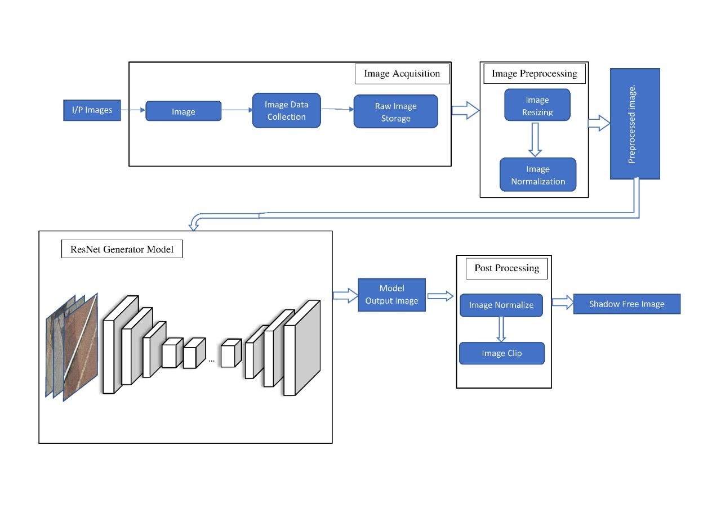
Approach / Solution
Concept Diagram :
( Clear detailed schematic / block diagram / flow chart depicting the proposed concept / solution )

Slide 4
Approach / Solution
A generative model was used as an approach. A generative model describes how a dataset is generated, in terms of a probabilistic model. By sampling from this model we are able to generate new data.
Specifically, CycleGAN technique was used. The CycleGAN is a technique that involves the automatic training of image-to-image translation models without paired examples. The models are trained in an unsupervised manner using a collection of images from the source and target domain that do not need to be related in any way.
So, the techniques that were used were, Convolutional Neural Network models as discriminator and a ResNet architecture for our generator, which is similar to a U-Net model in that it allows information from pervious layers in the network to skip ahead one or more layers with the help of residual blocks.
By using this technique the model was able to transfer style of the non-shadowed images to the shadowed ones and create a non shadowed image from a shadow image.
The problem(end case situation), of the model receiving a non shadowed image was by introducing a loss function during training so it doesn’t make any changes to the non-shadowed image.

Slide 5
Approach / Solution
Algorithm:
Acquire image from the memory
Load it onto RAM for faster accessibility and execution
Resize the image to the size where height = 128 and width = 128
Normalize the image so that all the pixel values lie between [1,0]
Load the model onto your RAM/ partial loading of model onto RAM incase of lower capacity
Give the pre-processed image as the input to the model
Obtain the results from the model
Normalize the pixels of the image of the output between [1,0]
Apply some image enhancements if needed.

Slide 6
Dataset(s) Analysis / Description
Dataset Capture / Preparation / Generation :
(Discuss the dataset generation process or if downloaded data provide details of what data & from where it was obtained etc… - 2 to 3 bullets only)
ISTD Dataset and SRD Dataset are used in the project.
https://drive.google.com/file/d/1I0qw-65KBA6np8vIZzO6oeiOvcDBttAY/view
Dataset Understanding / Analysis :
(Provide 2 to 3 bullets about what is your understanding of the data / opinion about the data)
The ISTD Dataset contains 1870 image triplets which is divided into train and test of 1330 and 540 images.
For each of the 1870 images there is a shadow image, its corresponding shadow mask and shadow free image.
Dataset Pre-Processing / Related Challenges (if any) :
(List out the challenges you fore see in data handling wrt problem definition – 2 to 3 bullets only)
Converting the image into size of 128x128x3.
Normalization of image(dividing it by 255).

Slide 7
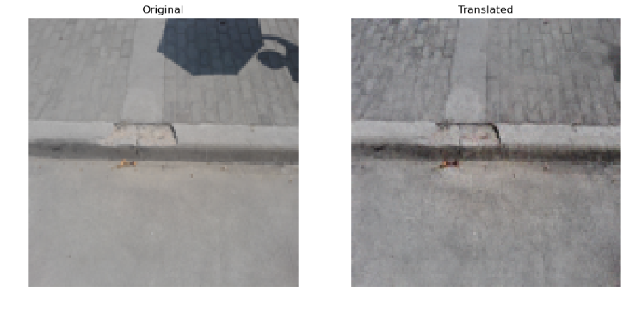
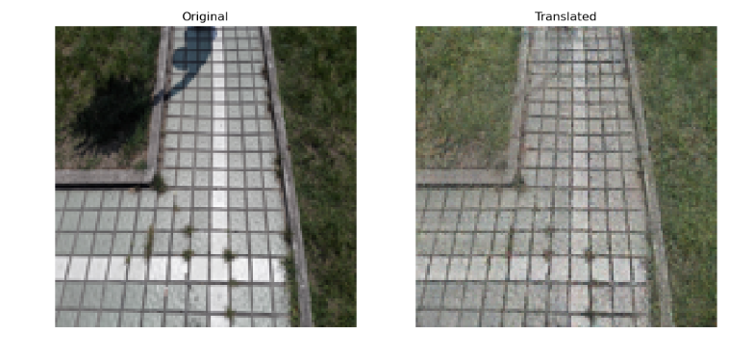
Experimental Results / Simulations / Observations
Results :
(provide numerical data / bar charts / plots / images / videos / tabulated results etc. Use full slide or multiple slides up to max 3 slides to demonstrate the results)
Structural Similarity Index(SSIM)
98%
98.3%

Slide 8
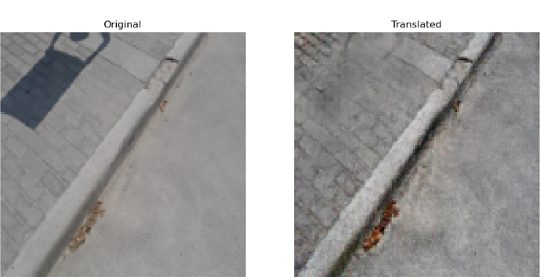
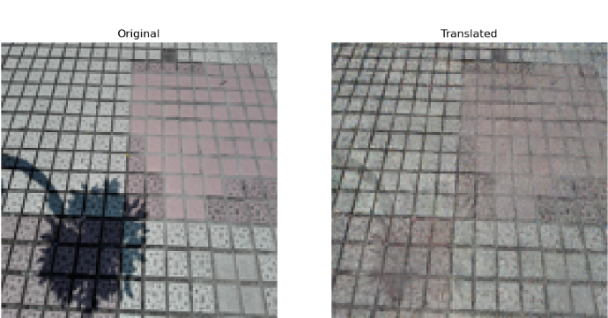
Experimental Results / Simulations / Observations
Structural Similarity Index(SSIM)
95%
96.4%

Slide 9
Experimental Results / Simulations / Observations
Major Observations / Conclusions & Challenges :
(provide details about your findings, experimental opinion – Use separate slide if necessary)
Observations
The total number of images trained – 1330.
Total number of test carried out – 540.
The average accuracy of current model is 95%.
Execution time for individual image is 0.0757 seconds.
Challenges
Images that are high dense shadow is observed to have higher energy level and hence the removal of the shadow is less significant.
This can be overcome by increasing the number of training epochs of the model.
If the number of training epochs have been increased, then it would be highly probable that the results would be much better.
Also for better results, a highly diverse dataset could be used during training.
Conclusion
The model is observed to give good shadow detections.

Slide 10
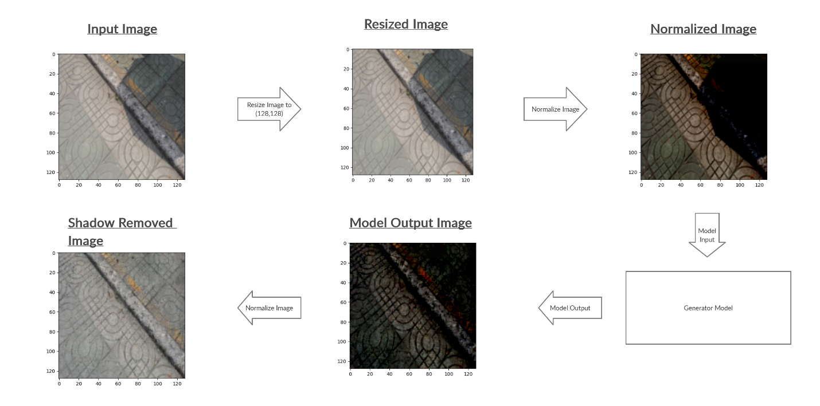
Experimental Results / Simulations / Observations

Slide 11
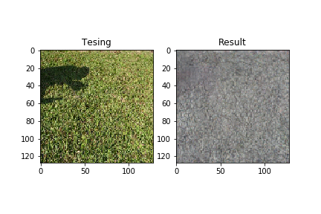
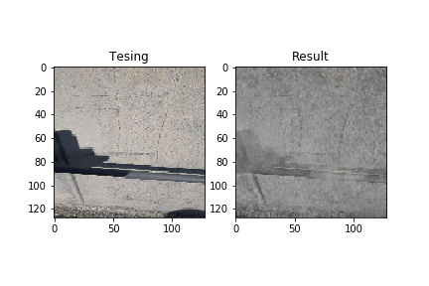
Experimental Results / Simulations / Observations
Challenges :
(Results of images completely outside our dataset)

Slide 12
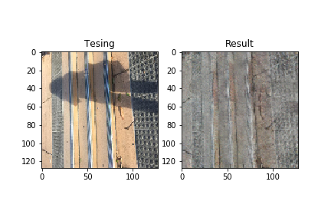
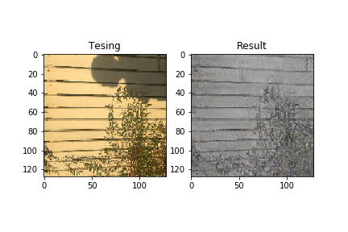
Experimental Results / Simulations / Observations
Challenges :
(Results of images completely outside our dataset)

Slide 13
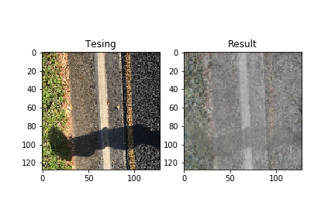
Experimental Results / Simulations / Observations
Challenges :
(Results of images completely outside our dataset)

Slide 14
Deliverable
Final Deliverables :
(Discuss in the form of bullets, what are the next steps to complete the solution, any road blocks / bottlenecks, any support needed from SRIB)
The final deliverable is a tensorflow file (.pb) format of size 28.6MB.
A portable model allowing the implementation of the processes in Samsung devices.
IP / Paper Publication Plan :
(Details of papers / patentable ideas / innovative aspects that can lead to patentable ideas)
The project is based on CycleGAN approach.
This process identified can be patented and published.

Slide 15
Work-let Closure Details
KPIs delivered/Expectations Met:
(Planned Expectations shared in Work-let vs Delivered Results)
PLANNED EXPECTATIONS | DELIVERED RESULTS
A C++ file with a tensorflow model which can detect and remove shadows from any given image | A tensorflow model which can detect and remove shadows from a given image
Code details:
<https://drive.google.com/drive/folders/1ZFLHtTPTB4hM7W0VcqkpBepZYXyObamL?usp=sharing>
Parameter | Details
KLOC [Lines of Code in Thousands] | [0.84 ]
Model /Algorithm Details | [ CycleGAN ]
Details of Datasets collected [No of files and source of Data– Images, Videos, Text] | [ ISTD DATASET - 1870 TRIPLETS]
List of Reports Uploaded [Name of All Documents uploaded] | [ loaders.py, layers.py,cyclegan.py,cyclegan_train.py,finalcoderun.py,final_model.h5,final_model.pb ]

Slide 16
Thank you

